Slide 1



Video Chat/Stream Platform
Made By :-
Mrudani Songade
Batch: B2
Roll no. : 39
Enrollment number: 21002170510032
Branch: AIDS

Slide 2
Introduction & Abstract
This Django-powered video chat/stream platform, seamlessly integrated with the Agora SDK, prioritizes user control and privacy.
With secure room access and the autonomy for users to leave at will, it ensures a comfortable and personalized experience.
This platform not only meets but redefines the expectations of online communication, prioritizing user control, security, and adaptability.

Slide 3


Overview of Technologies Used
Django Integration
Agora SDK Integration (JavaScript)
The platform leverages the robust and scalable features of the Django framework for smooth functionality.
A comprehensive integration with the Agora SDK streaming and chat capabilities.

Slide 4

Key Features of the Platform
User-Controlled Room Access:
One of the standout features is the ability for users to initiate or join rooms only if they possess the correct room name. This ensures a secure and private environment for communication.
Integration with Agora SDK:
The integration of the Agora SDK enhances the platform's audio and video communication capabilities.
Customizable Templating for Personalization
The platform's basic templating structure allows for easy customization

Slide 5
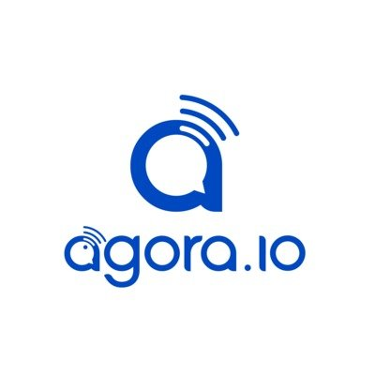
Seamless Video Chat and Streaming Experience
High-Quality Streaming
The platform offers seamless video chat and streaming, delivering high-quality visuals and smooth interactions.
User-Friendly Interface
Users can enjoy a user-friendly interface for effortless video chat and streaming experiences.

Slide 6




Future Work
Mobile Applications
Gamification Elements
Community Engagement
Develop mobile applications for iOS and Android platforms to extend the platform's accessibility
Introduce gamification elements to incentivize user engagement
Engaging with the user community to gather feedback and ideas for future platform enhancements.

Slide 7
Application of Video Chat Platform
1
Business Meetings
The platform is ideal for virtual Business meetings, offering a secure and professional environment.
Social Gatherings
2
For social gatherings, the platform provides a smooth video chat experience for participants.
3
Educational Use
Its functionality can be harnessed for educational purposes, creating an engaging virtual classroom environment.

Slide 8
Advantages
Enhanced Security
User Flexibility
Robust security features provide a safe environment for all interactions and transactions.
Users have the flexibility to tailor their experience and interactions according to their own specific needs.
Scalable Infrastructure
Rich User Experience
The platform's infrastructure is designed to scale seamlessly with growing user demands and requirements.
It offers a rich and immersive time enhancing the overall virtual interaction environment.

Slide 9
SYSTEM REQUIREMENTS
Software requirements
Operating system: Windows 10
Coding language : Python 3.8 (Django)
Tool Used :Agora SDK
Hardware requirements
Processor : intel core i5
Hard disk : 250GB
Monitor : 15"LED
RAM : 4GB
Input devices : Mouse ,Keyboard, Camera, Microphone

Slide 10
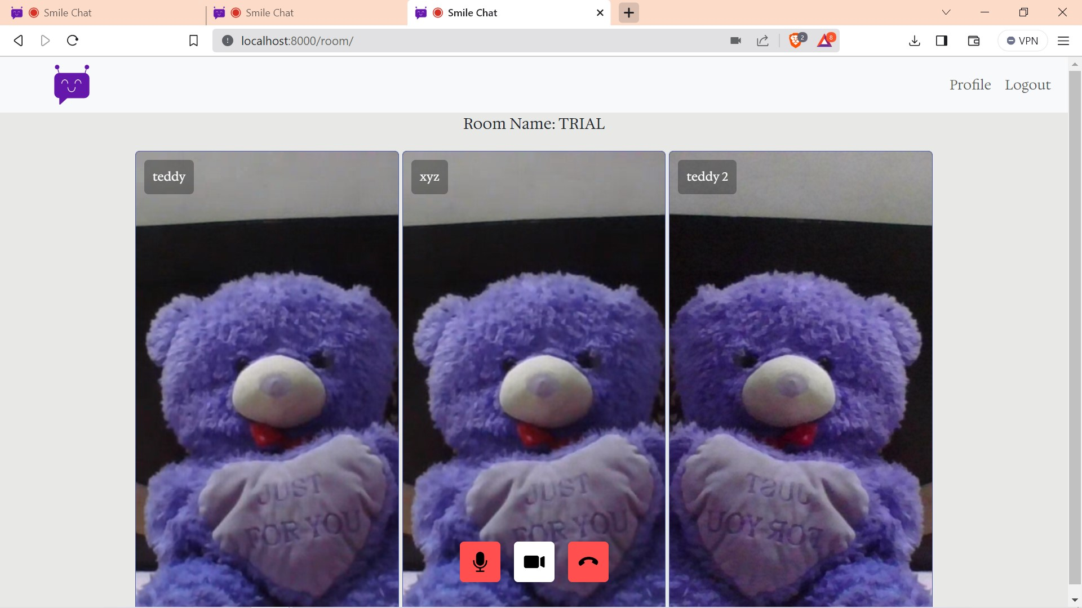
Output Example:

Slide 11
THANK YOU

